Slide 1
AI – Problem Solving by Searching By Er. Khushbu K. Sarraf
Unit 3

Slide 2
Why Search in AI?
Search helps AI systems find solutions in large problem spaces. Search algorithms provide a systematic and efficient way for AI systems to navigate through this space and find optimal or satisfactory solutions. Here are some reasons why search is crucial in artificial intelligence:
• Complex Problem Solving
• Unpredictable Environments
• Resource Efficiency
• Game Playing
• Planning and Decision Making
• Optimization
• Natural Language Processing
• Robotics, Medical Diagnosis etc.

Slide 3
Search in AI
What is a State?
A state is a snapshot of the problem at a particular moment.
Example:
In the 8-puzzle, a state is one specific arrangement of tiles.
In route finding, a state is the current city.
What is State Space?
The state space is the set of all possible states that can be reached from the initial state by applying valid actions.
A map of all possible situations the problem can be in.

Slide 4
Problem-Solving Agents
A problem-solving agent is a type of goal-based agent that plans actions to achieve specific goals. Operate in simple environments with clear goals and fixed sequences of actions.
How they work ?
The agent works through a four-phase problem-solving process:
Goal Formulation
Problem formulation
Search Method
Execute

Slide 5
Problem-Solving Agents
Goal Formulation
The agent first decides what it wants to achieve.
A goal defines the desired outcome.
Goals help organize behavior by reducing unnecessary actions.
Example (Romania map problem): The agent adopts the goal of reaching Bucharest.

Slide 6
Problem-Solving Agents
Problem formulation
The agent then defines the problem in a form suitable for search.
This includes:
States – possible situations of the agent (e.g., being in Arad, Sibiu etc.)
Actions – what the agent can do (e.g., drive from one city to another)
Initial state – where the agent starts (e.g., Arad)
Goal test – checks whether the goal is reached (e.g., current city = Bucharest)
Path cost – cost of actions (e.g., distance traveled)

Slide 7
Problem-Solving Agents
Search Method
Before acting in the real world, the agent:
Simulates possible action sequences
Explores different paths in the state space
Uses a search algorithm to find a solution
A solution is:
A sequence of actions that leads from the initial state to the goal state.
Example: Arad → Sibiu → Fagaras → Bucharest

Slide 8
Problem-Solving Agents
Execute
Once a solution is found:
The agent executes the actions one by one
Actions are carried out in the real environment
Example: The agent actually drives along the chosen cities in order.

Slide 9
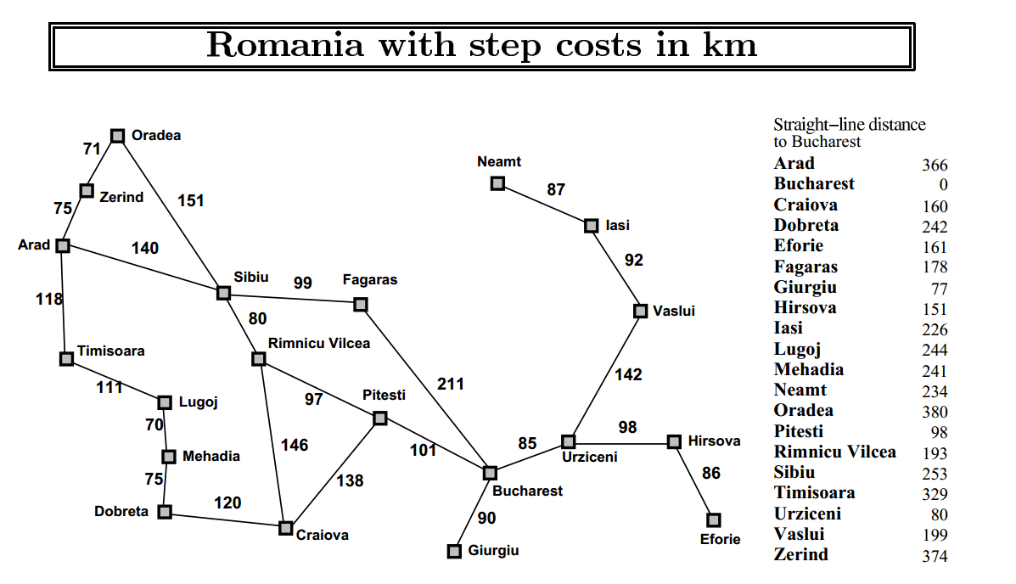
Problem-Solving Agents

Slide 10
Problem-Solving Agents
Search problems describe how an agent finds a solution by exploring different states.
State space - All possible situations the environment can be in.
Initial state - The starting point of the agent. Example: Arad
Goal state(s) -The state(s) the agent wants to reach. Example: Bucharest
Actions - Possible moves from a state.
Example: ACTIONS(Arad) = {ToSibiu, ToTimisoara, ToZerind}
Transition model - Describes the result of an action.
Example: RESULT(Arad, ToZerind) = Zerind
Action cost - Numeric cost of performing an action (distance, time, or money)
Path - A sequence of actions
Solution - A path from the initial state to a goal state
Optimal solution - The solution with the lowest total cost
State space representation -The problem can be shown as a graph
Nodes → states
Edges → actions

Slide 11
Measuring Problem-Solving Performance
We measure how good a search algorithm is using the following properties:
1. Completeness
Will it always find a solution if one exists?
Also correctly reports failure if no solution exists.
2. Cost Optimality
Does it find the best (lowest-cost) solution?
Important when actions have different costs (distance, time, money).
3. Time Complexity
How long does it take to find a solution?
Measured by: Time taken or Number of states/nodes explored.
4. Space Complexity
How much memory is required?
Depends on how many states are stored during the search.

Slide 12
Measuring Problem-Solving Performance
Complexity Measures (for Implicit State Space)
To compare algorithms, we use these symbols:
b (Branching factor) - The branching factor (b) is the average number of successor states generated from a single state.
How many choices does the agent usually have at each step?
Example
In the Romania map problem:
A city may connect to 2–4 other cities
So, branching factor b ≈ 3
In chess, b can be around 35, making search very expensive.

Slide 13
Measuring Problem-Solving Performance
d (Depth of solution) d is the number of actions in the optimal (best) solution. It tells us how deep the goal is in the search tree.
A larger d means:
More time
More memory
Example
Arad → Sibiu → Fagaras → Bucharest
Number of actions = 3
So, d = 3

Slide 14
Measuring Problem-Solving Performance
m (Maximum depth) m is the maximum length of any path in the state space.
It represents the deepest possible path, even if it is not a solution.
If the state space is infinite or has cycles:
m can be very large or infinite
DFS may never terminate.
Example
If a problem allows revisiting states repeatedly:
m → ∞ (infinite)
In a finite tree:
m is the deepest leaf level
Relationship Between b, d, and m
b controls how wide the tree grows
d controls how deep we must search to find the best solution
m controls the worst-case depth of the tree

Slide 15
Measuring Problem-Solving Performance
m (Maximum depth) m is the maximum length of any path in the state space.
It represents the deepest possible path, even if it is not a solution.
If the state space is infinite or has cycles:
m can be very large or infinite
DFS may never terminate.
Example
If a problem allows revisiting states repeatedly:
m → ∞ (infinite)
In a finite tree:
m is the deepest leaf level
Relationship Between b, d, and m
b controls how wide the tree grows
d controls how deep we must search to find the best solution
m controls the worst-case depth of the tree

Slide 16
Types of problem
In Artificial Intelligence, search problems are commonly classified into standardized problems and real-world problems.
1. Standardized Search Problems
Designed to illustrate and test search algorithms
Have a clear, exact, and fixed description
Used as benchmarks to compare algorithm performance
Easy to model and analyze
Characteristics
Well-defined state space
Known actions and costs
Same problem for everyone
Examples
Grid world problem
8-puzzle problem
Vacuum cleaner world

Slide 17
Types of problem
2. Real-World Search Problems
Problems whose solutions are used in real life
Not standardized – formulation varies from system to system
More complex and realistic
Characteristics
Different sensors and data sources
Environment may be dynamic or uncertain
Harder to model exactly
Examples
Robot navigation
Autonomous driving
Route planning with real traffic data

Slide 18
Types of problem
2. Real-World Search Problems
Problems whose solutions are used in real life
Not standardized – formulation varies from system to system
More complex and realistic
Characteristics
Different sensors and data sources
Environment may be dynamic or uncertain
Harder to model exactly
Examples
Robot navigation
Autonomous driving
Route planning with real traffic data

Slide 19
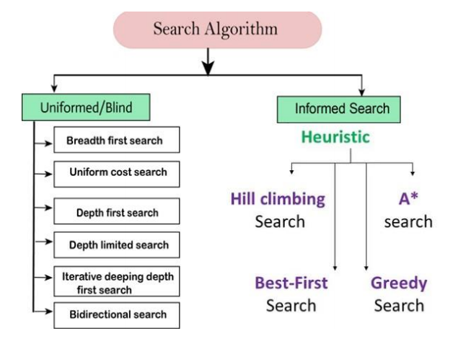
Search Algorithms
A search algorithm takes a search problem as input and
it returns:
A solution (path from start to goal), or
An indication of failure if no solution exists

Slide 20
Uninformed/Blind Search
Uninformed (Blind) Search algorithms search the problem space without using any extra knowledge about where the goal is.
Does not use domain knowledge
Works in a brute-force manner (go on all possibilities)
Uses only: Initial state, Actions/operators, Goal test, Path cost (if applicable). Because it searches without guidance, it is called blind search.
How It Works
The algorithm: It explores the search tree step by step and continues until the goal node is found or all possible nodes are explored
Key Characteristics
No heuristic information
Simple to implement
May explore many unnecessary nodes
Can be slow and memory-intensive for large problems

Slide 21
Uninformed/Blind Search
Types of Uninformed Search Algorithms
Breadth-First Search (BFS)
Depth-First Search (DFS)
Depth Limited Search (DLS)
Iterative Deepening Depth-First Search (IDDFS)
Uniform Cost Search (UCS)
Bidirectional Search

Slide 22
Breadth-First Search (BFS)
BFS searches the state space level by level
It explores all nodes at one depth before moving to the next level
Because it searches breadthwise, it is called Breadth-First Search
Breadth-first search implemented using FIFO queue data structure.
How BFS Works
Expand the root (start) node first
Then expand all its immediate successors
After that, expand the successors of those nodes
Continue this process level by level until the goal is found

Slide 23
Breadth-First Search (BFS)
Advantages of BFS
Guaranteed to find a solution BFS will find a solution if at least one solution exists.
Finds the shortest solution If multiple solutions are available, BFS returns the minimum solution, i.e., the one with the least number of steps (when all step costs are equal).
Disadvantages of BFS
High memory requirement BFS must store all nodes at each level to expand the next level, which consumes a lot of memory.
Time-consuming for deep solutions If the goal is far from the root, BFS explores many levels, leading to high time consumption.

Slide 24
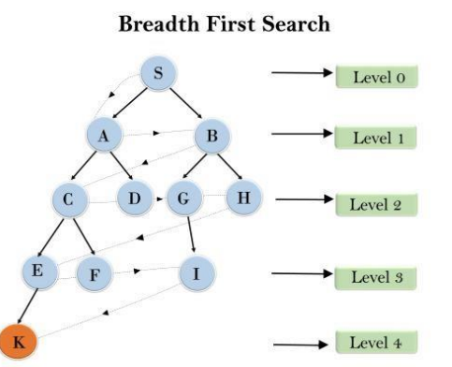
Breadth-First Search (BFS)
Example:
traversed path is
S--->A--->B---->C--->D---->G--->H--->E---->F---->I---->K

Slide 25
Breadth-First Search (BFS)
Step | Visited Node | Action | Queue
0 | - | initialize root node A | S
1 | S | Equeue children of S | A,B
2 | S,A | Equeue children of A | B,C,D
3 | S,A,B | Equeue children of B | C,D,G,H
4 | S,A,B,C | Equeue children of C | D,G,H,E,F
5 | S,A,B,C,D | Leaf node D | G,H,E,F
6 | S,A,B,C,D,G | Equeue children of G | H,E,F,I
7 | S,A,B,C,D,G,H | Leaf node H | E,F,I
8 | S,A,B,C,D,G,H,E | Equeue children of E | F,I,K
9 | S,A,B,C,D,G,H,E,F | Leaf node F | I,K
10 | S,A,B,C,D,G,H,E,F,I | Leaf node F | K
11 | S,A,B,C,D,G,H,E,F,I,K | Goal | -

Slide 26
Performance Measures of Search
1) Time Complexity -BFS expands all nodes up to the depth of the shallowest goal.
Let: b = branching factor (average number of children per node) , d = depth of the shallowest solution
Nodes expanded:
1 + b + b² + b³ + … + bᵈ
Time Complexity: O(bᵈ)
2) Space Complexity - BFS stores all nodes at the current frontier (level) in memory. At depth d, there can be about bᵈ nodes waiting in the queue.
Space Complexity: O(bᵈ)
3) Completeness - BFS is complete. If a solution exists at a finite depth, BFS will always find it.Because BFS checks every node level by level without skipping any.
4) Optimality - BFS is optimal when path cost does not decrease with depth.If all step costs are equal, BFS finds the shortest path (fewest steps).Because BFS reaches the goal at the smallest depth first.

Slide 27
Depth-first search (DFS)
Depth-First Search (DFS) always expands the deepest node in the frontier first.
It starts from the root node and follows one path as deep as possible before backtracking.
DFS explores depth-wise, not level-wise.
That is why it is called Depth-First Search.
DFS uses a Stack (LIFO – Last In, First Out)

Slide 28
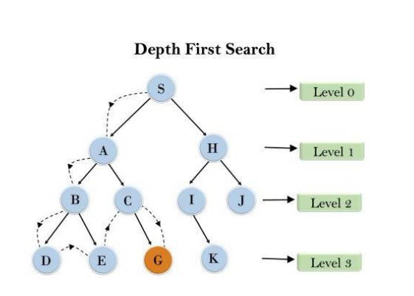
Depth-first search (DFS)
Example:
traversed path is
S--->A--->B---->D--->E---->C--->G--->H---->I---->K---->J

Slide 29
Depth-first search (DFS)
Step | Node Popped | Action | Stack(Top to bottom) | Visited Node
0 | - | Initialize with node A | S
1 | S | Push children of S | A,H | S
2 | A | Push children of A | B,C,H | S,A
3 | B | Push children of B | D,E,C,H | S,A,B
4 | D | Leaf node, backtrack | E,C,H | S,A,B,D
5 | E | Leaf node, backtrack | C,H | S,A,B,D,E
6 | C | Push children of C | G,H | S,A,B,D,E,C
7 | G | Leaf node, backtrack | H | S,A,B,D,E,C,G
8 | H | Push children of C | I,J | S,A,B,D,E,C,G,H
9 | I | Push children of C | K,J | S,A,B,D,E,C,G,H,I
10 | K | Leaf node, backtrack | J | S,A,B,D,E,C,G,H,I,k
11 | J | Goal Node found |  | S,A,B,D,E,C,G,H,I,K,J

Slide 30
Depth-first search (DFS)
Advantages of DFS
Low memory requirement Stores only the path from the root to the current node
Faster if goal is deep If DFS chooses the correct path early, it can reach the goal faster than BFS
Disadvantages of DFS
Not complete May fail to find a solution even if one exists
May enter infinite loops Especially in graphs with cycles or infinite depth
Not optimal Does not guarantee the shortest or least-cost solution

Slide 31
Performance Measures of Search
Completeness - DFS is complete only in a finite state space. If:
The search tree is finite, and DFS explores all nodes, then DFS will find a solution if one exists.
Time Complexity- DFS explores nodes depth-wise.
Let:
b = branching factor
m = maximum depth of the search tree
(m can be much larger than d, the depth of the shallowest solution)
Nodes explored: 1 + b + b² + b³ + … + bᵐ
Time Complexity: O(bᵐ)
Space Complexity- DFS stores only the current path from root to the deepest node
Space Complexity: O(bm)
Much less memory than BFS.
Optimality - DFS is NOT optimal. It may find a longer or higher-cost path, even if a shorter solution exists, DFS does not guarantee the shortest path.

Slide 32
BFS vs DFS
Feature | BFS | DFS
Traversal | Level by level | Depth first
Data Structure | Queue | Stack / Recursion
Completeness | Complete (finite graph) | Complete (finite graph)
Optimality | Yes (unweighted graph) | No
Time Complexity | O(b^{d}) | O(b^{m})
Space Complexity | O(b^{d}) | O(bm)
Memory Usage | High | Low
Best Used For | Shortest path, levels | Deep exploration

Slide 33
Depth Limited Search (DLS)
Depth-Limited Search is a version of Depth-First Search (DFS) where we set a maximum depth limit and do not go beyond it.
DLS starts from the root node and explores deeper like DFS.
It stops searching when it reaches the given depth limit.
Nodes at the depth limit are treated as leaf nodes (they are not expanded further).
This helps avoid the problem of infinite paths that can occur in DFS.
Failure conditions
DLS can fail in two ways:
Standard Failure
Means no solution exists in the entire search space.
Cutoff Failure
Means a solution may exist, but not within the given depth limit.

Slide 34
Depth Limited Search (DLS)
Advantages
Memory efficient (uses less memory, like DFS).
Prevents infinite loops caused by very deep or infinite paths.
Disadvantages
Incomplete: If the solution is deeper than the limit, DLS will not find it.
Not optimal: It may not find the shortest or best solution when multiple solutions exist.

Slide 35
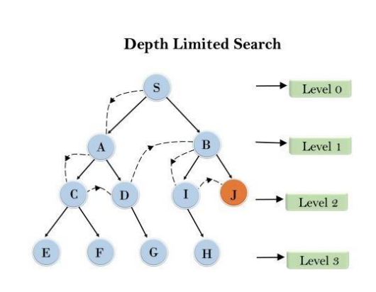
Depth Limited Search (DLS)
Example:
Limit = 2
Traversed path is : S--->A--->C---->D--->B---->I---->J

Slide 36
Depth Limited Search (DLS)
Completeness: DLS search algorithm is complete if the solution is above the depth limit.
Time Complexity: Time complexity of DLS algorithm is O(b^{ℓ}).
Space Complexity: Space complexity of DLS algorithm is O(b×ℓ).
Optimal: Depth-limited search can be viewed as a special case of DFS, and it is also not optimal even if ℓ>d.

Slide 37
Iterative Deepening Search (IDS)
Iterative Deepening Depth-First Search (IDDFS) is an uninformed search algorithm that combines the strengths of Depth-First Search (DFS) and Breadth-First Search (BFS).
How IDDFS Works
IDDFS performs Depth-Limited Search (DLS) repeatedly.
It starts with a depth limit of 0, then 1, 2, 3, …
At each iteration, it runs DFS up to the current depth limit.
The process continues until the goal node is found.
This way, the algorithm gradually discovers the optimal depth without knowing it in advance.

Slide 38
Iterative Deepening Search (IDS)
Key Characteristics
Uses DFS strategy at each iteration
Expands nodes level by level, like BFS
Finds the shallowest (optimal) solution in an unweighted graph
Requires much less memory than BFS
Why IDDFS Is Useful
When the search space is very large
When the depth of the goal node is unknown
When memory is limited, but optimality is still required
Note:Iterative Deepening Depth-First Search uses DFS at each iteration, but by gradually increasing the depth limit, it effectively explores the search space level by level like BFS.

Slide 39
Iterative Deepening Search (IDS)
Advantages
Combines BFS’s completeness and optimality with DFS’s low memory usage
Finds the shortest path to the goal (like BFS)
Low memory requirement
Simple to implement
Disadvantages
Repeated work: nodes are re-expanded in each iteration
Slightly higher time cost compared to BFS due to repetition
Not ideal when branching factor is extremely high

Slide 40
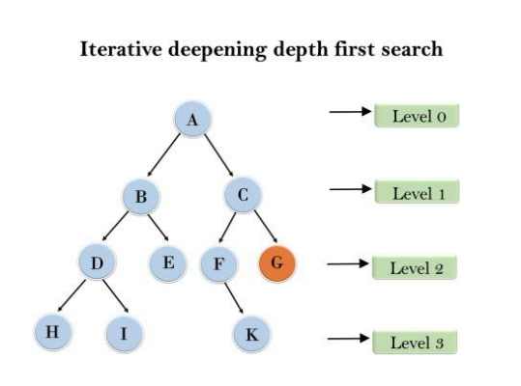
Iterative Deepening Search (IDS)
Example:
1'st Iteration-----> A
2'nd Iteration----> A, B, C
3'rd Iteration------>A, B, D, E, C, F, G
4'th Iteration------>A, B, D, H, I, E, C, F, K, G
In the fourth iteration, the algorithm will find the goal node.

Slide 41
Iterative Deepening Search (IDS)
Completeness: This algorithm is complete is ifthe branching factor is finite.
Time Complexity: Let's suppose b is the branching factor and depth is d then the worst-case time complexity is O(b^{d}).
Space Complexity: The space complexity of IDDFS will be O(b*d).
Optimal: IDDFS algorithm is optimal if path cost is a non-decreasing function of the depth of the node

Slide 42
Uniform-Cost Search (UCS)
Uniform-cost search is a searching algorithm used for traversing a weighted tree or graph. This algorithm comes into play when a different cost is available for each edge.
The primary goal of the uniform-cost search is to find a path to the goal node which has the lowest cumulative cost.
Uniform-cost search expands nodes according to their path costs form the root node. It can be used to solve any graph/tree where the optimal cost is in demand.
A uniform-cost search algorithm is implemented by the priority queue. It gives maximum priority to the lowest cumulative cost.
Uniform cost search is equivalent to BFS algorithm if the path cost of all edges is the same

Slide 43
Uniform-Cost Search (UCS)
Advantages of Uniform-Cost Search
Uniform-Cost Search is optimal because it always expands the path with the lowest total cost.
It guarantees finding the minimum-cost solution if all edge costs are non-negative.
Disadvantages of Uniform-Cost Search
UCS does not consider the number of steps taken, only the path cost, which may lead to exploring many nodes.
If the graph has cycles or zero-cost edges, the algorithm may get stuck in an infinite loop.
It can be slow and memory-intensive for large graphs.

Slide 44
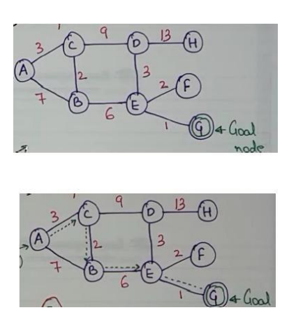
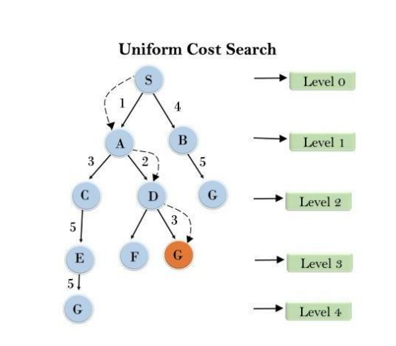
Uniform-Cost Search (UCS)
Example:

Slide 45
Uniform-Cost Search (UCS)
Step | Priority Queue | Explored
0 | (A,cost=0) | {}
1 | (C,3),(B,7) | {A}
2 | (B,5),(D,12) | {A,C}
3 | (E,11),(D,12) | {A,C,B}
4 | (D,12),(G,12),(F,13) | {A,C,B,E}
5 | (G,12),(F,13),(H,25) | {A,C,B,E,D}
6 | Goal Node Reached | {A->C->B->E->G}

Slide 46
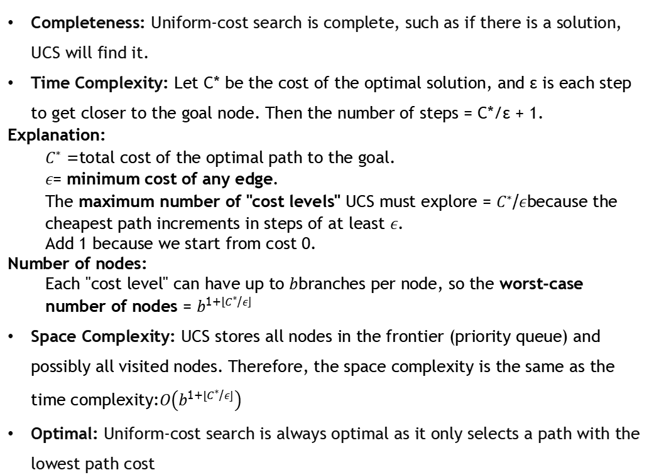
Uniform-Cost Search (UCS)
Completeness: Uniform-cost search is complete, such as if there is a solution, UCS will find it.
Time Complexity: Let C* be the cost of the optimal solution, and ε is each step to get closer to the goal node. Then the number of steps = C*/ε + 1.
Explanation:
$C^{∗}$= total cost of the optimal path to the goal.
$ε$= minimum cost of any edge.
The maximum number of "cost levels" UCS must explore = $C^{∗}/ε$because the cheapest path increments in steps of at least $ε$.
Add 1 because we start from cost 0.
Number of nodes:
Each "cost level" can have up to $b$branches per node, so the worst-case number of nodes = $b^{1+\left\lfloor C^{∗}/ε\right\rfloor }$
Space Complexity: UCS stores all nodes in the frontier (priority queue) and possibly all visited nodes. Therefore, the space complexity is the same as the time complexity:$O\left(b^{1+\left\lfloor C^{∗}/ε\right\rfloor }\right)$
Optimal: Uniform-cost search is always optimal as it only selects a path with the lowest path cost

Slide 47
Bidirectional Search
Bidirectional search algorithm runs two simultaneous searches, one form initial state called as forward-search and other from goal node called as backward-search, to find the goal node.
Bidirectional search replaces one single search graph with two small subgraphs in which one starts the search from an initial vertex and other starts from goal vertex. The search stops when these two graphs intersect each other.
Bidirectional search can use search techniques such as BFS, DFS, DLS, etc

Slide 48
Bidirectional Search
Advantages
Bidirectional search is fast.
Bidirectional search requires less memory
Disadvantages
Implementation of the bidirectional search tree is difficult.
In bidirectional search, one should know the goal state in advance

Slide 49
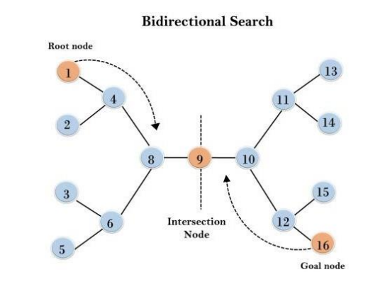
Bidirectional Search
Example:
The algorithm terminates at node 9 where two searches meet.

Slide 50
Bidirectional Search
Completeness: Bidirectional Search is complete if we use BFS in both searches.
Time Complexity: Time complexity of bidirectional search using BFS is O(b^{d}).
Space Complexity: Space complexity of bidirectional search is O(b^{d}).
Optimal: Bidirectional search is Optimal.

Slide 51
Informed (Heuristic) Search
Uses extra knowledge (heuristics).
Guides search toward goal.
More efficient than uninformed search.

Slide 52
Greedy Best First Search
Chooses node closest to goal.
Uses heuristic h(n).
Fast but not optimal.

Slide 53
A* Search
Uses cost + heuristic.
f(n) = g(n) + h(n).
Complete and optimal with admissible heuristic.
Widely used in maps and games.

Slide 54
Local Search
Considers only current state.
Does not keep full path history.
Used for optimization problems.

Slide 55
Hill Climbing
Moves to best neighboring state.
Greedy local search.
Can get stuck in local maxima.

Slide 56
Simulated Annealing
Improves hill climbing.
Allows bad moves with probability.
Avoids local maxima.

Slide 57
Game Playing in AI
Competitive environment.
Multiple agents with conflicting goals.
Uses adversarial search.

Slide 58
Minimax Algorithm
Used in two-player games.
Maximizer tries to maximize score.
Minimizer tries to minimize score.

Slide 59
Alpha-Beta Pruning
Optimization of minimax.
Prunes unnecessary branches.
Reduces computation.

Slide 60
Constraint Satisfaction Problems (CSP)
Problem defined by variables and constraints.
Goal is to satisfy all constraints.
Examples: Sudoku, map coloring.

Slide 61
Applications of CSP
Scheduling problems.
Resource allocation.
Puzzle solving.
Robotics and NLP.

